Slide 1



Team 3: Wind Farm Project in Gujarat, India
Wind Farm Project Development, WiSe 2024/25
Presented by: Matriculation No.
Patil Rahul 750532
Mozafary Mostafa 750247
Soni Karan 760153
Guided by: M.Eng. Marina Blohm
Date : 15.01.2025
Place: Flensburg

Slide 2
Agenda
1
2
3
4
5
Introduction
Environmental Impact and Conflicts
Legal Framework
Wind Farm Development
Transportation
6
7
8
9
10
Land Leasing
Economic Analysis
Barrier and Obstacles
Project Timeline
Future Strategies

Slide 3
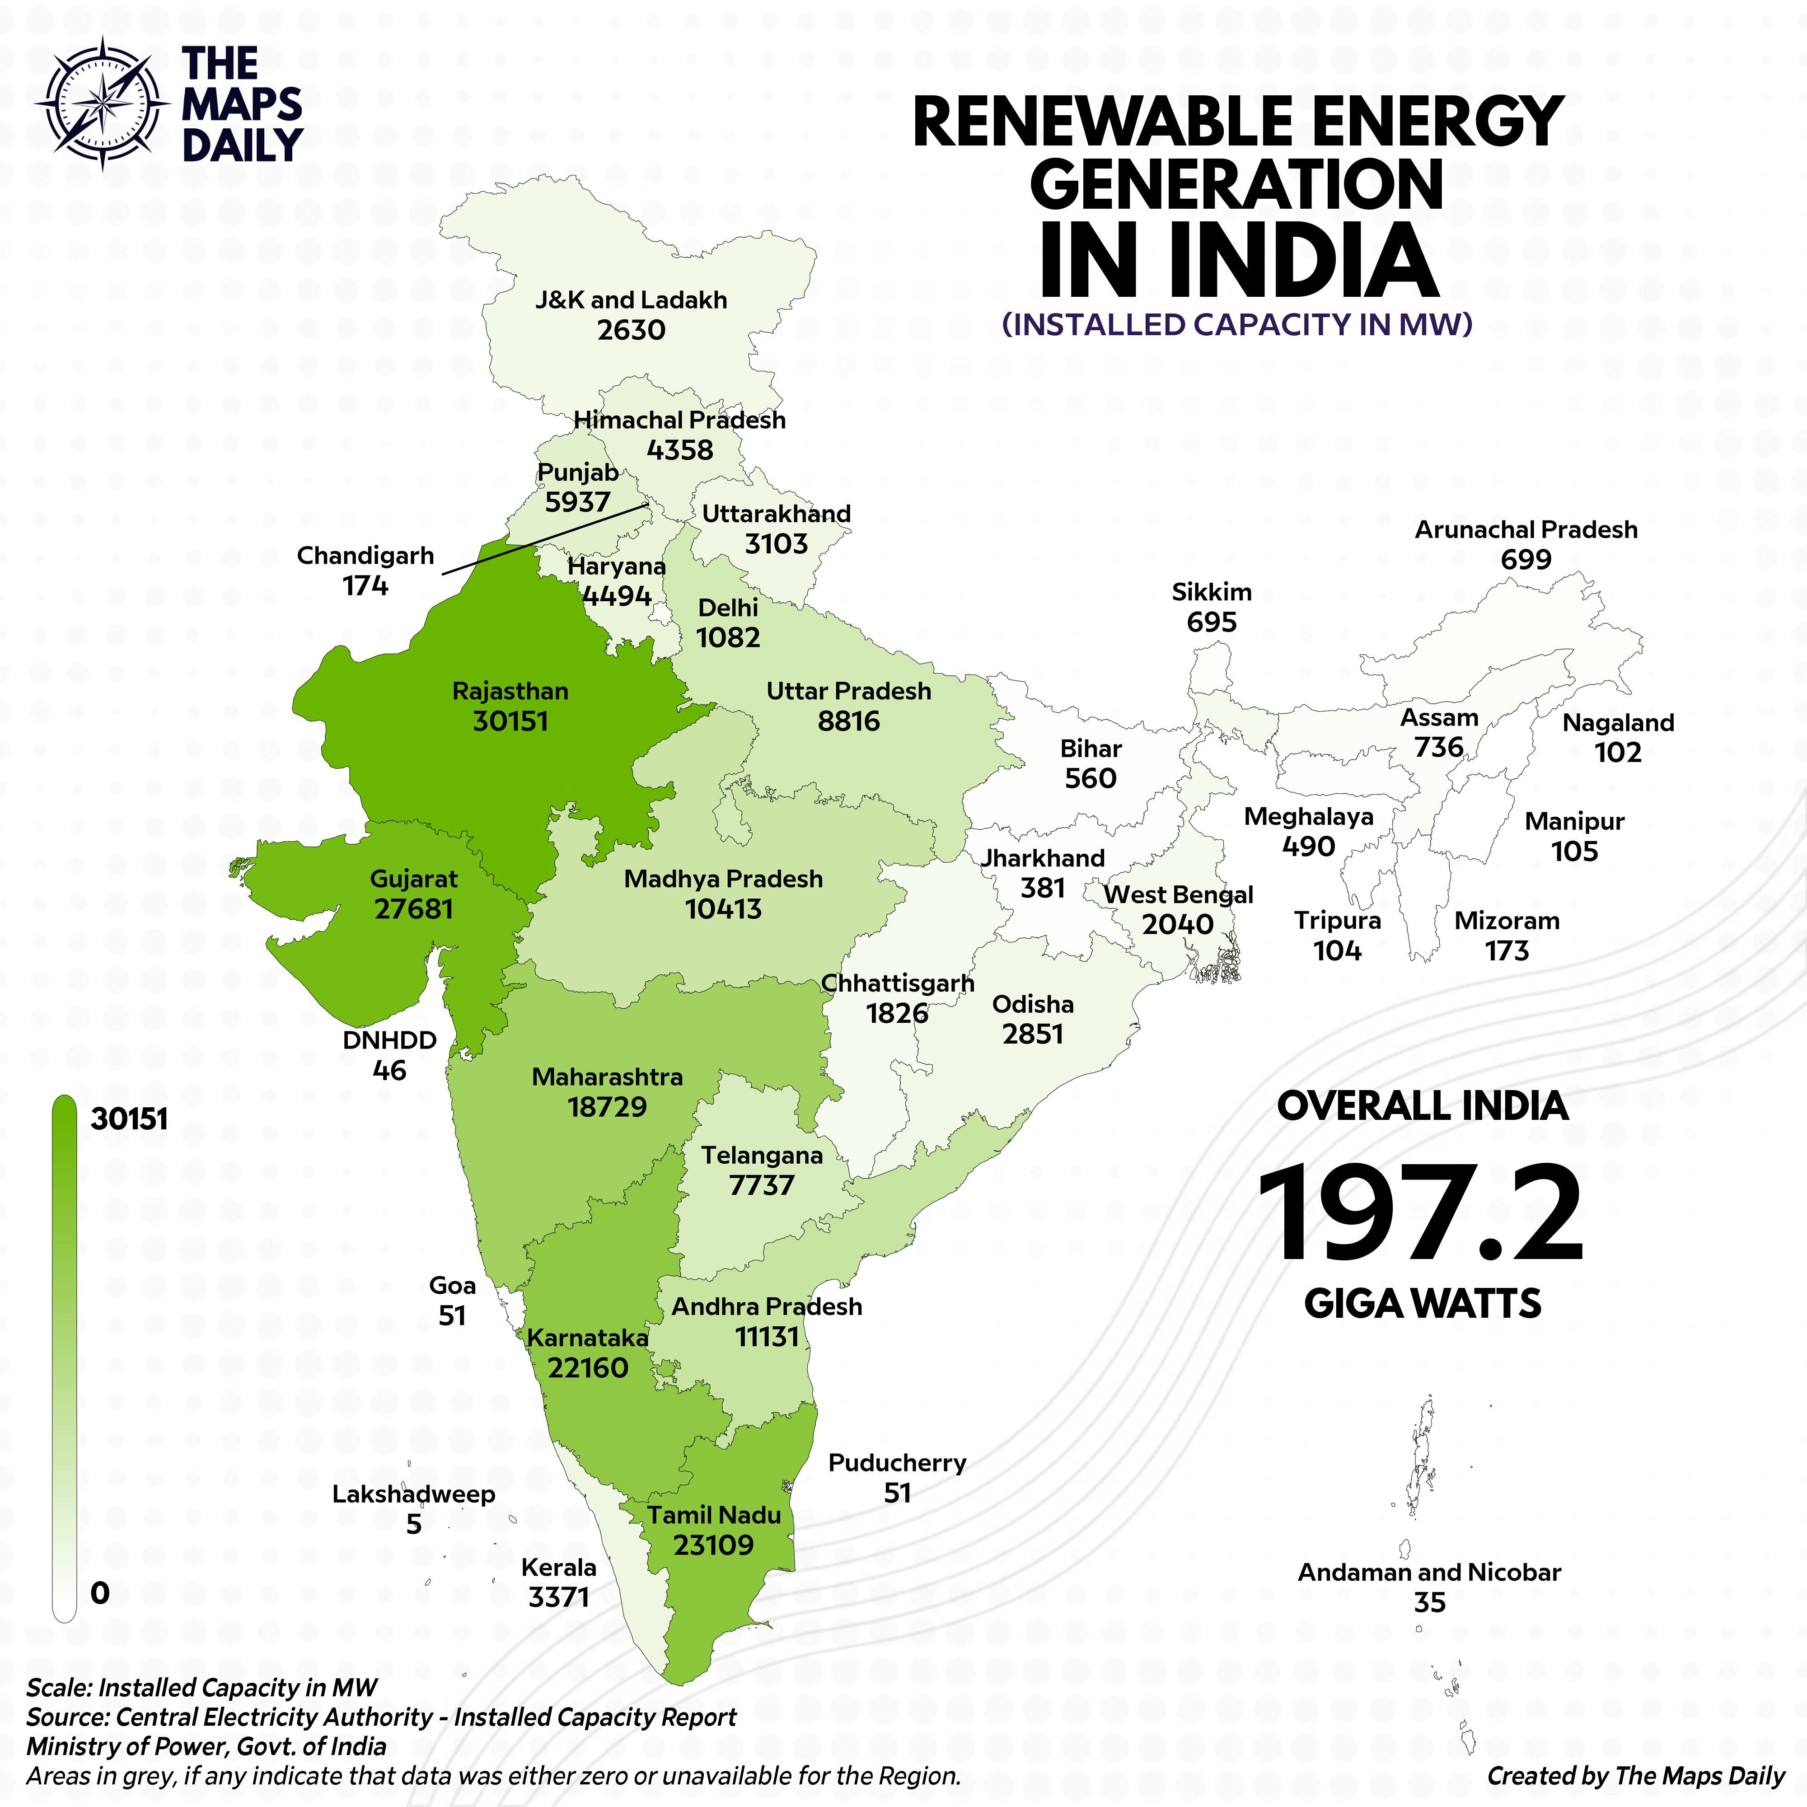
1. Introduction
India:
India ranks fourth in terms of installed wind power capacity
High Wind potential 695 GW with minimum 32% CUF(at 130 M HH)
Ambitious Target(Wind) : 140 GW by 2030 (48 GW Current)
Energy Security
Figure 1.1: Information of renewable energy generation in India [38]

Slide 4
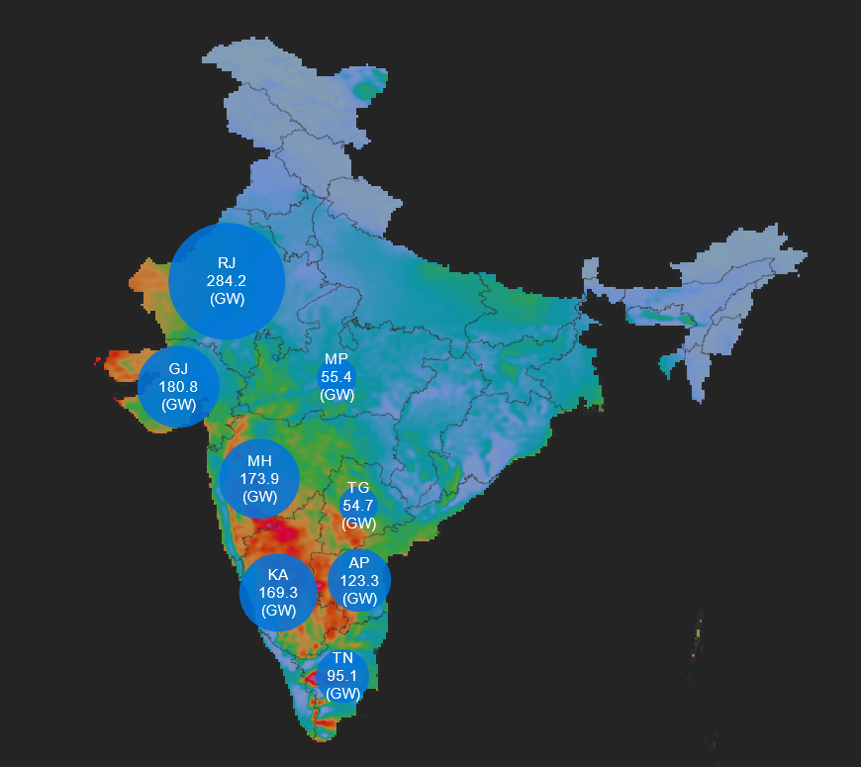
1. Introduction
Gujarat:
As May 2024, makes it the leading state in India for wind energy.
12.2 GW installed wind power capacity (26% Of total capacity)
Second rank, Tamil Nadu 11 GW
Why?
Geographic advantages
Government supports
Land policy
Tax benefits(First 10 Years no taxes)
Figure 1.2: Information of capacity wind potential in India [39]

Slide 5
2. Legal Framework
Gov.
Body
Ministry of New and Renewables (MNRE)
Central Agencies
National Institute of Wind Energy(NIWE)
State
Agencies
Gujarat Energy Development Agency(GEDA)
Ministry for Environment, forest and Climate change(MoEFCC)
Ministry of Defence (MoD)
Directorate General of Civil Aviation
Gujarat Power Corporation Limited (GPCL)
Gujarat Pollution Control Board(GPCB)
Revenue Department and Local Panchayat

Slide 6

2. Legal Framework
Consent to Establish from GSPCB
NOC from State Electricity board
Land Allotment letter
Permits and approvals:
NOC from DLIR Department
Permission for Forest Department
NOC from Mining Department
NOC from AAI and MoD
Power Purchase Agreement
NOC from Village Panchayat

Slide 7
2. Legal Framework
Micro siting guidelines:
Criteria | Buffer Distance
Micro siting within Wind Farm | 3D-2D
Public Roads, railway tracks, highways, buildings, public institutions | HH+0.5∙RD+5m
Eco-Sensitives Zones | 10 KM
Forest | 6.6 M from Ground (Power Lines)
Satic Air Defence Radar | 10 KM
Airports and Airstrips | 20 KM
Rivers | 250 M
Table 2.1: Information of micro siting guidelines [7]

Slide 8
3. Wind Farm Development
Identification of potential site
Pre-feasibility study
Grid connectivity
Land acquisition and approvals
Environmental and social impact assessment
Financial planning
Wind farm development

Slide 9
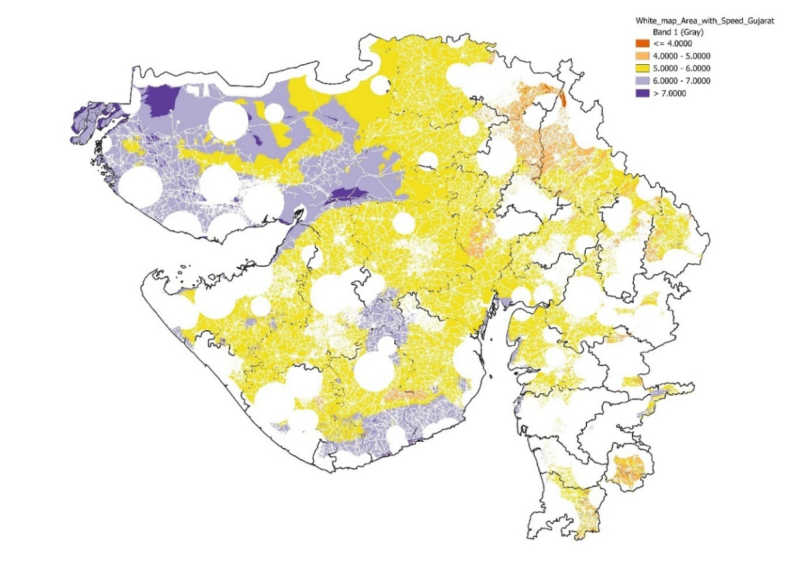
3. Wind Farm Development
Identification of Potential Sites (QGIS)
Analyse Wind site:
Wind speed data at 100m height
Coordinate Reference System: WGS 84/ UTM zone 43N, Authority ID: EPSG:32643
GIS Layers | Distances [m]
Buildings | 250
Forests | 10,000
Military Areas | 10,000
Railways/ Industrial | 250
Roads | 250
Airports/ Airfields | 20,000
Rivers | 250
Table 3.1: GIS layers information [own]
Integrated wind speed data onto the white map layer [Use the clip Raster by Mask Layer Tool]
Figure 3.1: White map area [own]

Slide 10
3. Wind Farm development
Pre-Feasibility study
Criteria For site selection
b
Wind Resource Availability
Grid Infrastructure
Environmental considerations
Topography and Terrain
Land Availability
Soil Conditions
Logistics

Slide 11
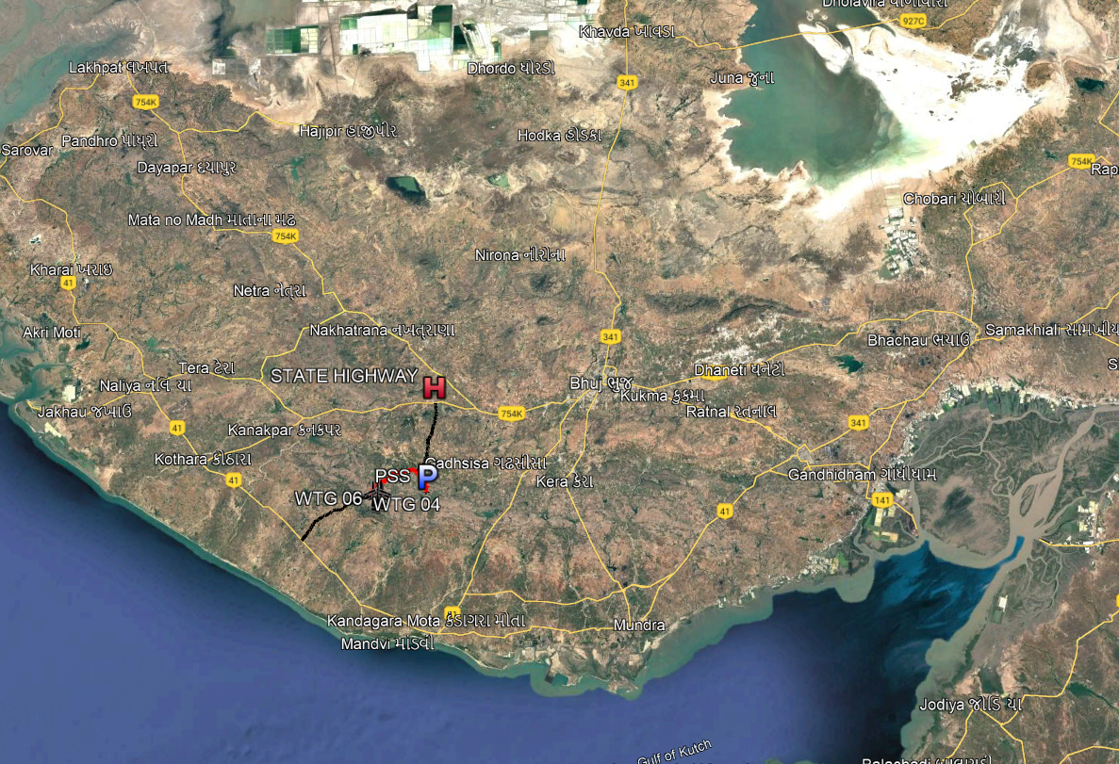
3. Wind Farm development
Selection of site
Figure 3.2: White map area [own]
Figure 3.3: Wind farm location [own]

Slide 12
3. Wind Farm development
Selection of site
Figure 3.2: White map area [own]
Figure 3.3: Wind farm location [own]

Slide 13
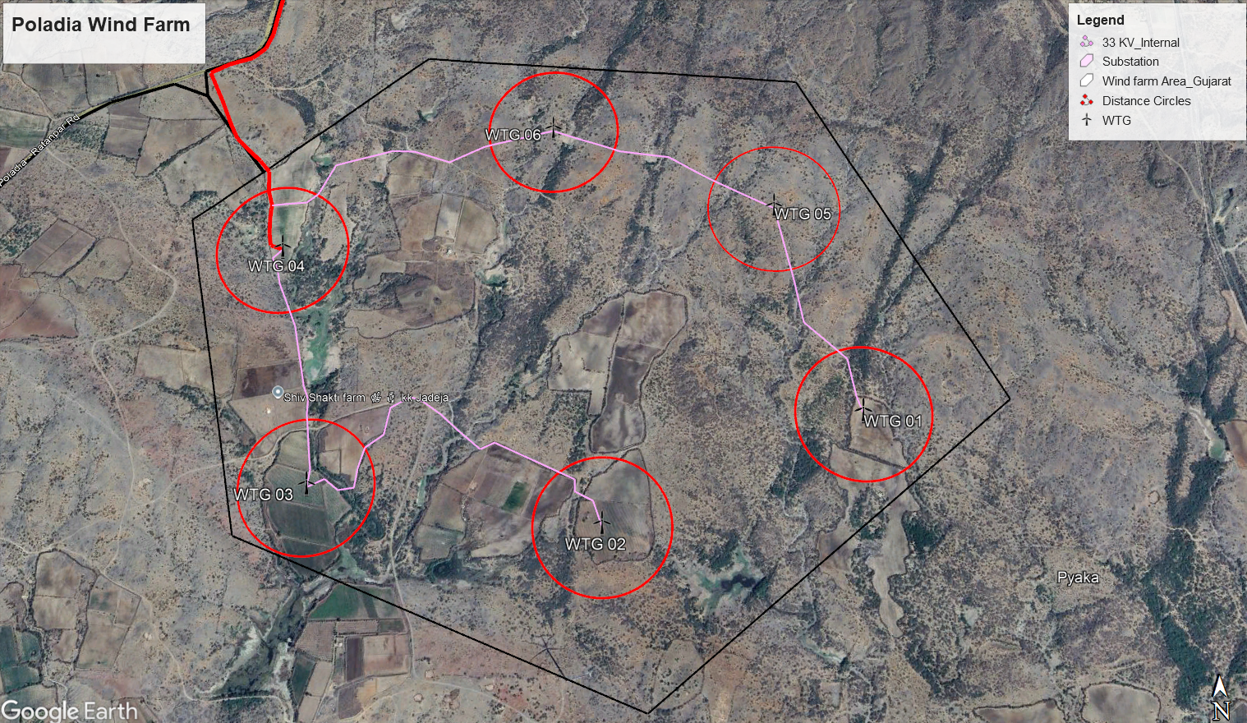
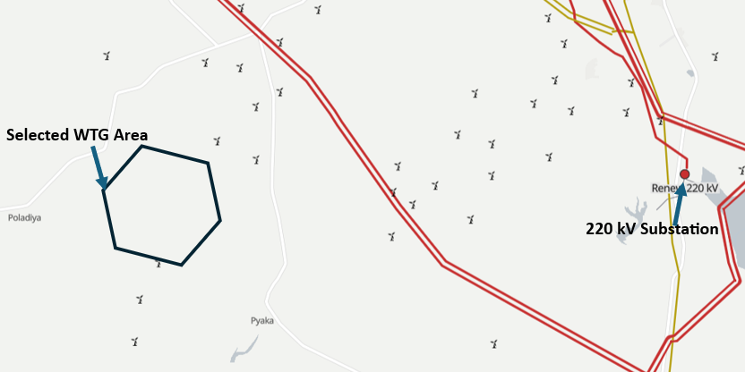
3. Wind Farm development
Site selection
Used Google Earth Pro for a comprehensive site assessment
Figure 3.4: Poladia wind farm [own]
Figure 3.5: Poladia wind farm[own]

Slide 14
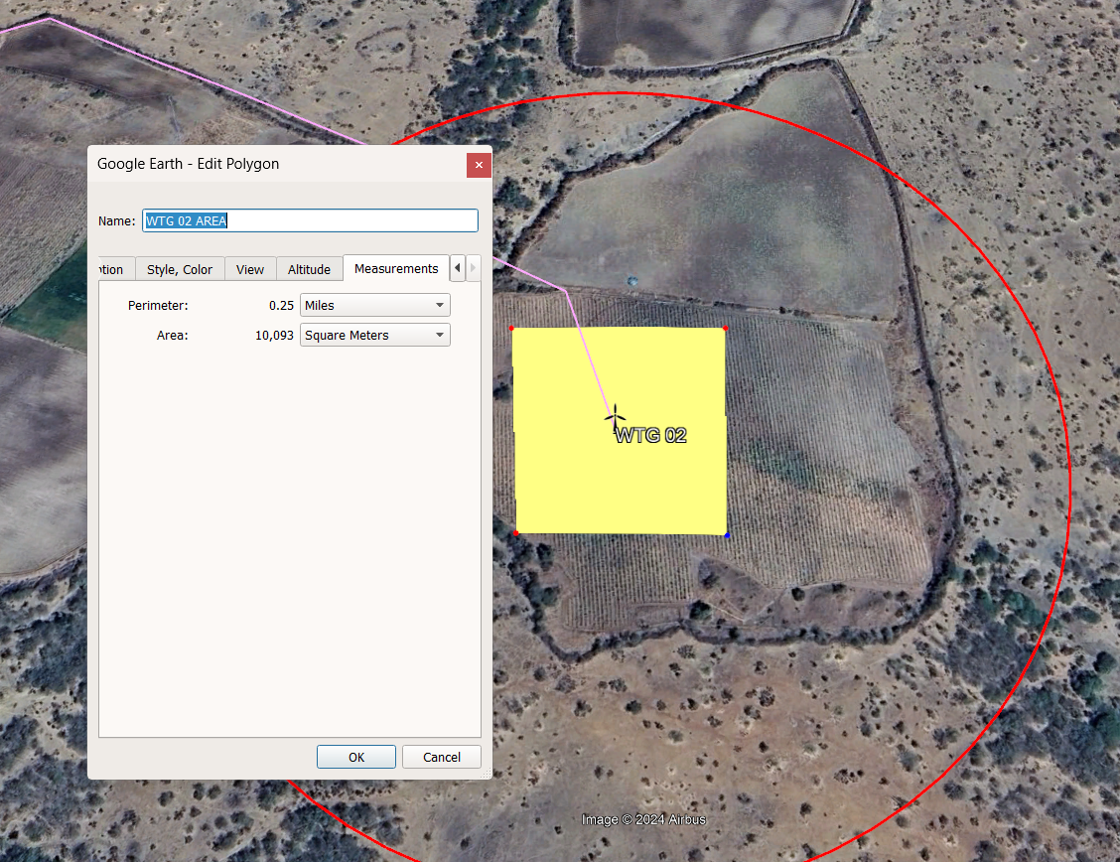
3. Wind Farm Development
Site selection
Type of Land and Soil Condition
Soil :- Residual soil with reddish brown in color
Land :- Private farmland (100 X 100 m)
Figure 3.6: Poladia wind farm [own]

Slide 15
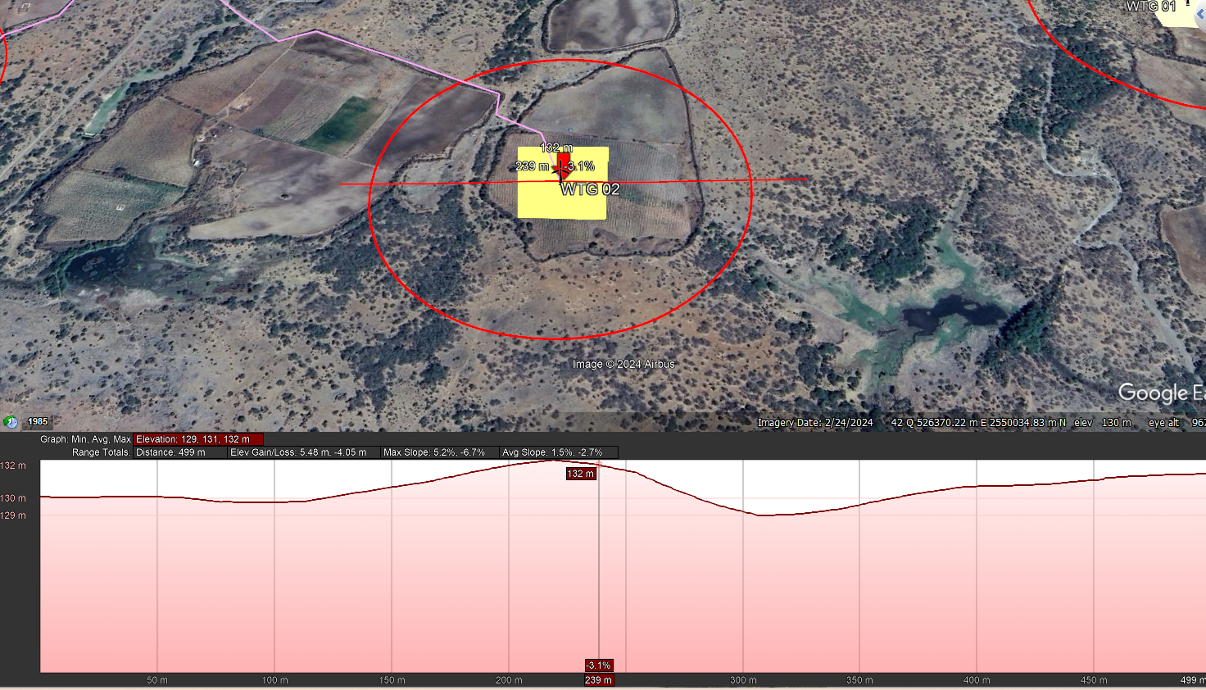
3. Wind Farm Development
Site selection
Elevation Profile of Site
Figure 3.7: Poladia wind farm [own]

Slide 16
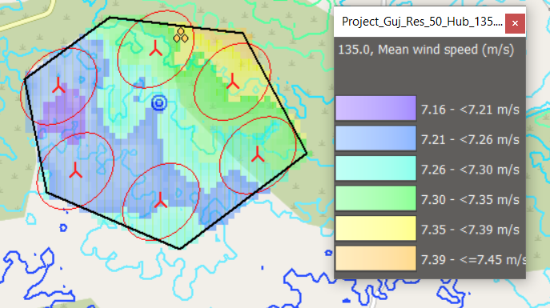
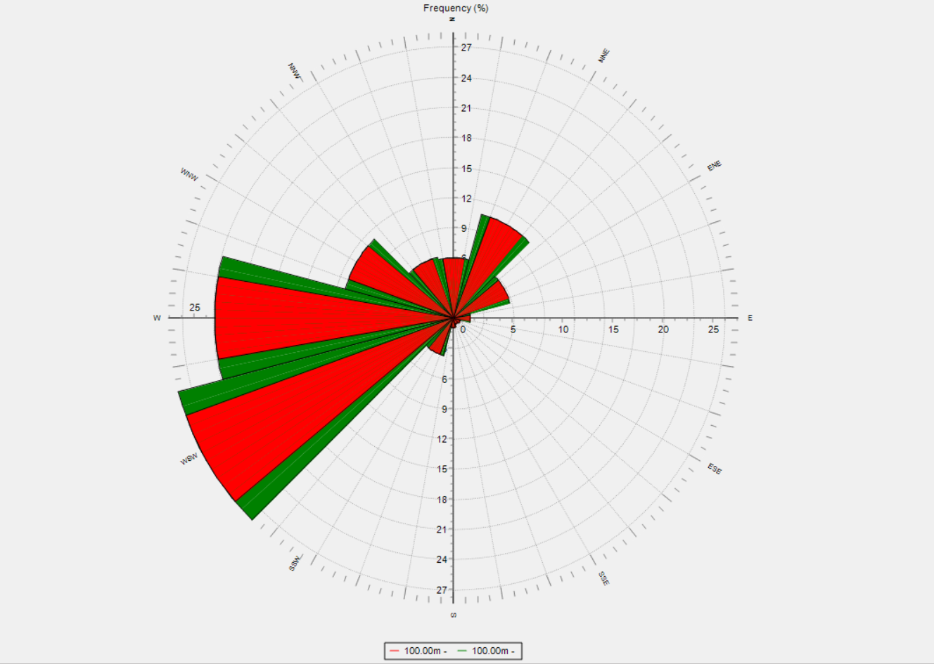
3. Wind Farm Development
Predominant Wind direction of Site
Six Suzlon 2.1 MW wind turbines, strategically positioning them to account for wind direction
Figure 3.9: Wind rose [40]
Figure 3.8: Poladia wind farm [own]

Slide 17
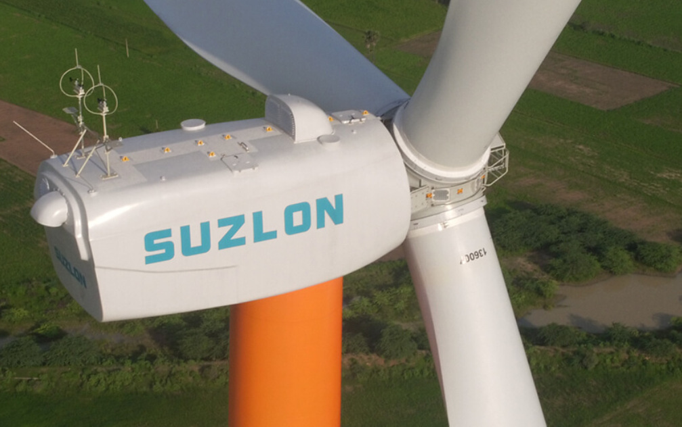
3. Wind Farm Development
Selection of WTGs
Wind Farm Capacity :- 12.6 MW
Turbine:- S97*2100(112 m HH)
Why Suzlon?
Local Manufacturer
High-capacity utilization factor (CUF)
Low Cost Availability
Logistics
Figure 3.10: SUZLON wind turbine [41]

Slide 18
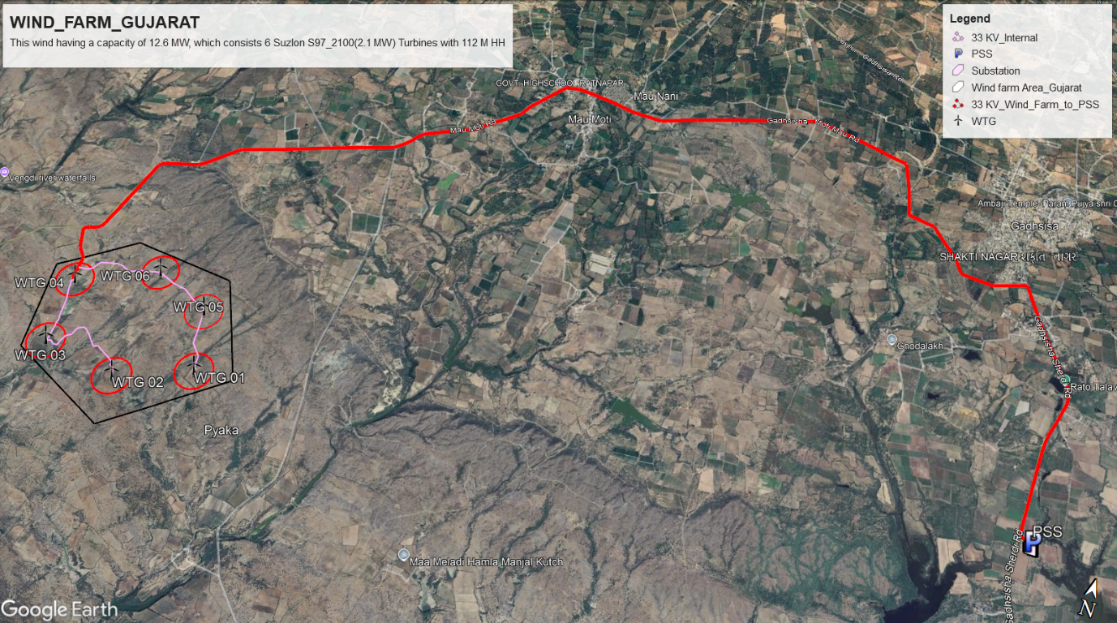
3. Wind Farm Development
Grid infrastructure and cable routing
Our wind farm has a capacity of 12.6 MW, which is relatively below 20 MW. Therefore, we utilized an available substation.
The substation, named Renew Wind Energy (AP2) Pvt Ltd, operates at 33/220 kV.
The length of the 33 kV line from the inside wind farm is 4.41 Km and from wind farm area to the pooling substation is 16 km.
Followed existing roads for transmission line in order to avoid conflicts and permissions.
Figure 3.11: Grid infrastructure and cable routing [own]

Slide 19
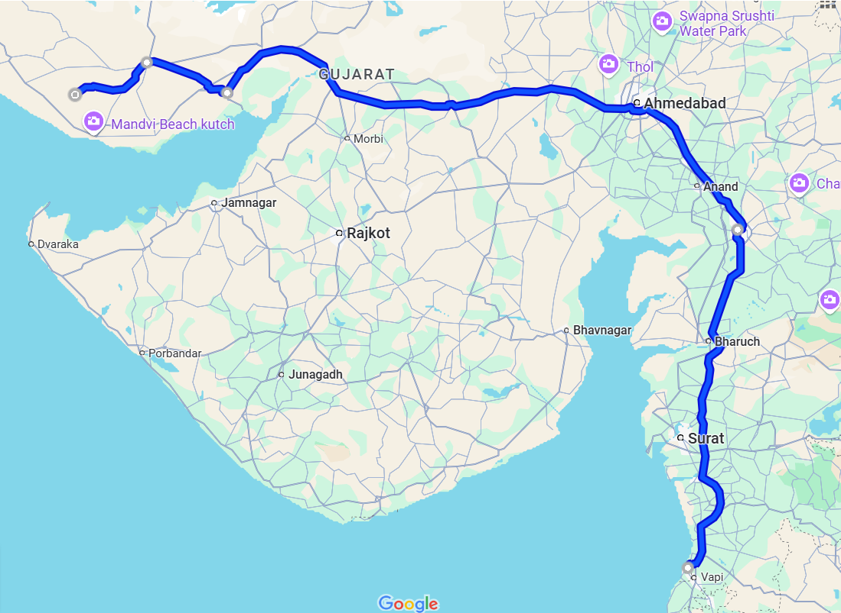

4. Transportation
3
Wind farm location: Poladia, Gujarat, India
754k
4
NH27
NH64
NE1
Manufacturing Locations | Wind Turbine Manufacturing components | Distance between Manufacturing location to Wind farm [km]
Daman [1] | Nacelle, Nacelle cover, Hub | 743
Bhuj [4] | Rotor blades | 57
Gandhidham, [3] | Tower | 136
Vadodara [2] | Electrical | 544
2
NH4
Table 4.1: Wind manufacturing components of SUZLON company [18]
NH48
1
Figure 4.1: Transportation route from manufacturing place to wind farm [18] [45]

Slide 20
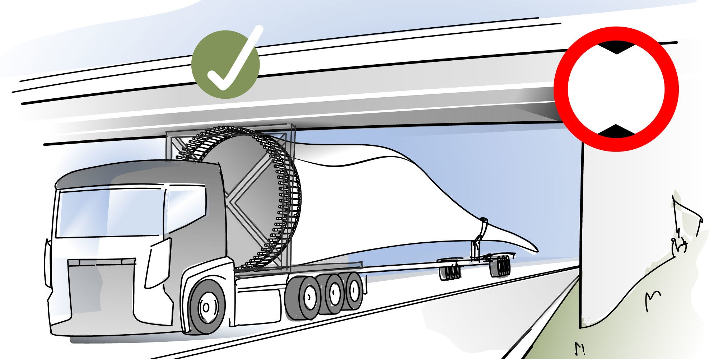
4. Transportation
Maximum Permissible Dimensions for Transportation:
Height: Up to 4.75 meters for indivisible loads (e.g., nacelles, blades).
Width: 3.0 meters
Length: Extendable mechanical trailers: Up to 50 meters for goods of exceptional length (e.g., wind turbine blades).
leichtbau.dlr.de
Figure 4.2 [46]
Route & Permits:
Special goods require special route permissions.
25 km Distance Between State highway to our Wind Farm:

Slide 21
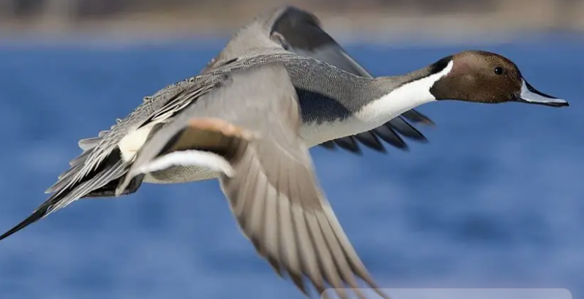
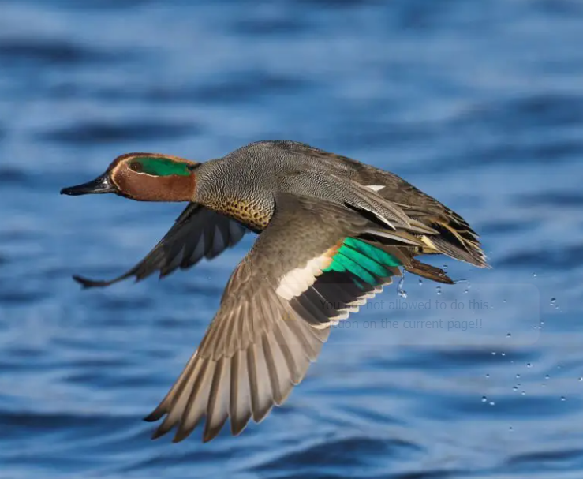
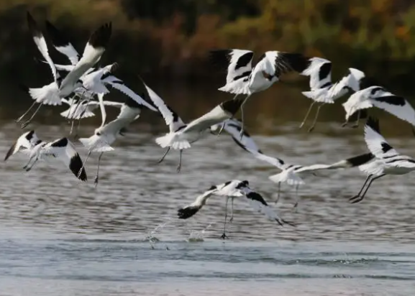

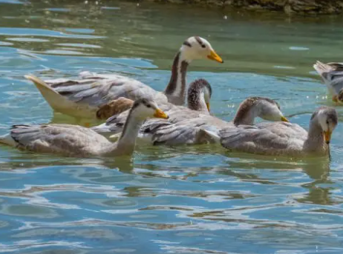
5. Environment Impact and Conflicts
Environmental Conflicts in Wind Energy Projects
Biodiversity Impact:
Top 5 migratory birds in Gujarat
Pied Avocet, Eurasian Teal, Northern Pintail, Bar-headed Geese, Ruddy Shelduck
Figure 5.1 [49]

Slide 22
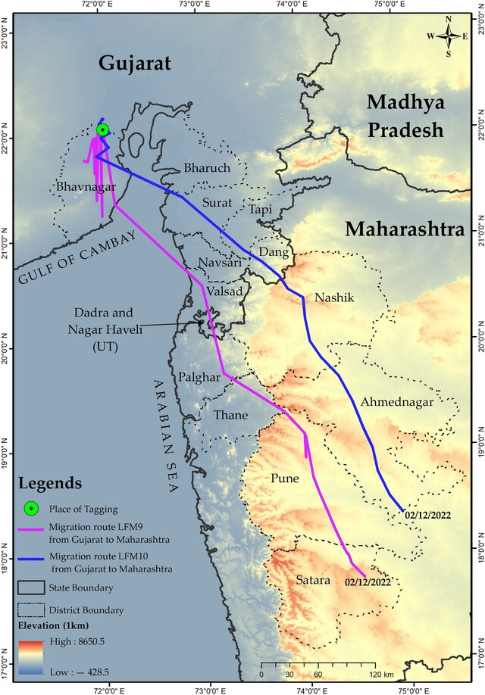
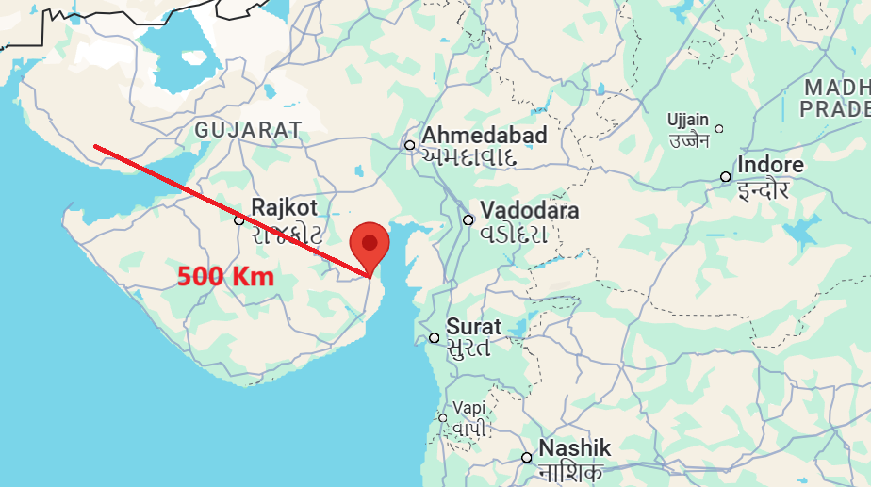
5. Environment Impact and Conflicts
Environmental Conflicts in Wind Energy Projects
Gujarat has important habitats of critically-endangered White-backed and Long-billed Vultures. About half the world population of the endangered Lesser Florican breeds at the grasslands of (source: fatbirder.com)
Figure 5.2: Distance to flight corridor [own]
Figure 5.3: Birds flight corridor Gujarat-India [50]

Slide 23
6. Land Leasing
Land Leasing Overview:
Accordig to Gujurat goverment leasing policy 2023
Duration and Terms:
Lease Period: 40 years
Annual Rent: ₹15,000 (€150–€170) per 10,000 m² area
Rent increase: 15% every 3 years
Advance Payment: Annual rent and taxes must be paid in advance (12% simple interest after 90 days for late payments).
Security Deposit: Equal to one year’s rent + 1% service charge + stamp duty.
Eligibility and Allocation:
Financial Stability: Minimum net worth ₹1200 crore (€130.44 million).
Renewable Energy Experience: Minimum 500 MW capacity.
Land Allocation Limit: Only sufficient land for producing 30 lakh metric tones of green hydrogen per year.[15]

Slide 24
6. Land Leasing
Land Leasing Overview:
Accordig to Gujurat goverment leasing policy 2023
Application and Approval Process:
Pre-Feasibility Report:
Applicants must demonstrate capability to produce green hydrogen.
Review Committees:
Applications evaluated by a Committee of Experts.
High-Power Committee makes final recommendations.
Tripartite Agreement:
Signed between the Collector, Gujarat Power Corporation Limited (GPCL), and the Applicant.

Slide 25

6. Land Leasing
Land Leasing Overview:
Accordig to Gujurat goverment leasing policy 2023
Usage and Compliance:
Dedicated Use: Leased land must be exclusively used for green hydrogen production.
Development Timeline: Projects must develop infrastructure and achieve 50% capacity within 3 years and full capacity within 8 years.
No Subleasing: The leased land cannot be subleased to third parties.
Figure 6.1 [47]

Slide 26

6. Land Leasing
Land Leasing Overview:
Accordig to Gujurat goverment leasing policy 2023
Governance and Oversight:
Nodal Agency (GPCL): Periodic project monitoring to ensure milestones.
High Power Committee (HPC): production standards
Revenue Department: Ensures land allocation aligns with state requirements
Figure 6.2 [48]

Slide 27
6. Land Leasing
Land Leasing Overview:
Private land Approval Process:
Step 1: Title Clearance
Checking all historical ownership records.
Ensuring there are no legal issues associated with the land.
Step 2: Conversion to Old Tenure Land
Land in Gujarat is often classified as "new tenure" (with restrictions on sale or use).
Developers must convert it to "old tenure" to remove restrictions.
Step 3 :Obtaining 89A Permission from revenue department
this permission is required to formally register the land transaction.
Accordig to Gujurat goverment leasing policy 2023

Slide 28
6. Land Leasing
Land Leasing Overview:
Accordig to Gujurat goverment leasing policy 2023
Private land Approval Process:
Step 4: Leasing agreement
formal agreement with the landowner, documenting the
agreed price, terms of payment, and timelines for the transaction.
Step 5: Obtain 65 Kh Permission
Land classified as agricultural must be converted to non-agricultural (NA) for setting
up infrastructure like wind turbines.[16]

Slide 29
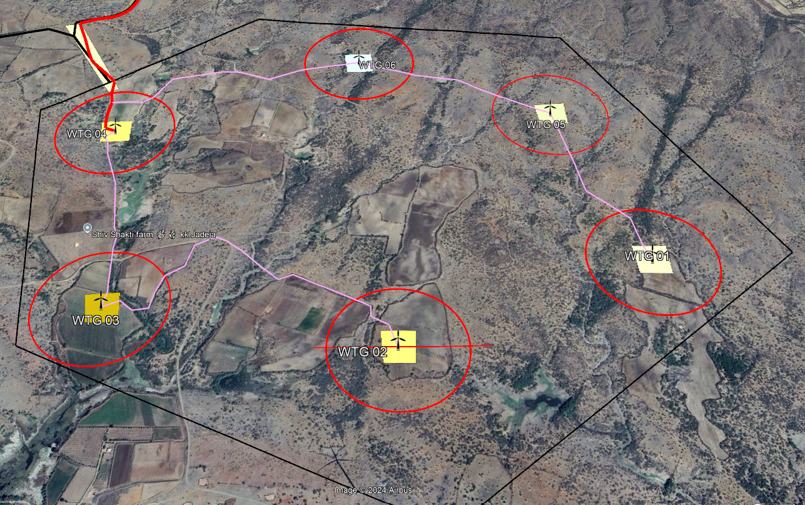
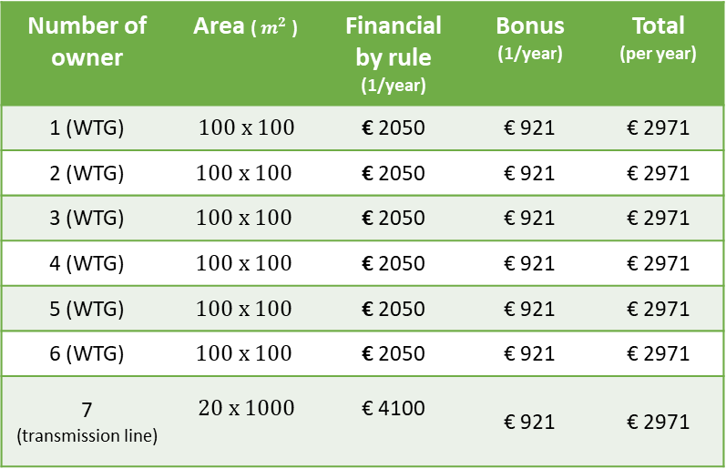
6. Land Leasing
Land Leasing strategy
Fixed amount + Flexible amount + Agricultural losses compensation
Flexible amount $=0.5\%∙Annual income (Euro)$
Number of owner | Area ( $m^{2}$ ) | Financial by rule (1/year) | Bonus (1/year) | Total (per year)
1 (WTG) | $$100 x 100$$ | € 2050 | € 921 | € 2971
2 (WTG) | $$100 x 100$$ | € 2050 | € 921 | € 2971
3 (WTG) | $$100 x 100$$ | € 2050 | € 921 | € 2971
4 (WTG) | $$100 x 100$$ | € 2050 | € 921 | € 2971
5 (WTG) | $$100 x 100$$ | € 2050 | € 921 | € 2971
6 (WTG) | $$100 x 100$$ | € 2050 | € 921 | € 2971
7 (transmission line) | $$20 x 1000$$ | € 4100 | € 921 | € 2971
Table 5.1: Land leasing own strategy [own]
Figure 5.5: Information of landowner [own]

Slide 30
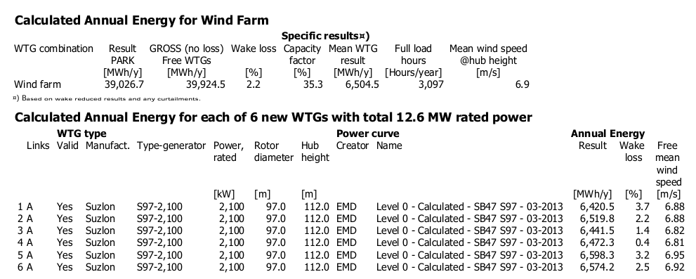
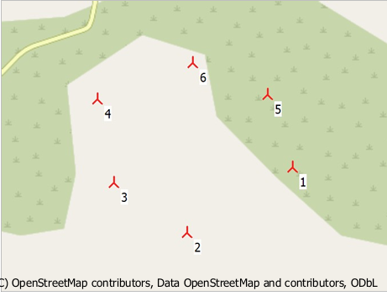
7. Economic Analysis
Input Parameters of Annual Energy For Wind Farm:
One of the most aspect for optimization
Improving efficiency and effectiveness
Figure 7.1: Wind pro report [own]
Figure 7.2: Wind pro report [own]

Slide 31
7. Economic Analysis
Input Parameters to calculate Profit analysis calculation:
Parameter | Economics | Unit
Number of WT | 6 | -
Installation output | 2100 | KW
Total output | 12600 | kW
Gross Energy Yield | 39924500 | KWh/a
Total losses | 2.20 | %
Net Energy Yield | 399,046,161 | kWh
Site Quality | 71.04 | %
Feed in Tariff | 0.033 | Euro/kWh
Total Investment Costs (CAPEX) | 98,07,253 | Euro
Total Operating Costs (OPEX) | 1,05,000 | Euro
Constant Payment Loan Type (Debt ratio) | 72.73 | %
Equity | 26,74,327 | Euro
Term | 17 | Years
Interest rate of Bank | 9.0 | %
Debt Capital | 71,32,926 | Euro
Inflation rate | 5.16 | %
Calculated by use of WindPro
INR 3 per kwh
Capital costs:
1 MW = INR 70 million (Euro 0.791 million)
Operating costs:
1 MW = INR 0.75 million/year = (Euro 0.105 million)
Last 10 years average
Table 7.1: Input parameters for calculating profit analysis [own]

Slide 32

7. Economic Analysis
Income vs Years:
$$Income=Net energy yield \left(kwh\right) ∙Feed in tariff \left(\frac{Euro}{kWh}\right)$$
Income: 1.29 Million Euro/ year
operation period: 20 years
Figure 7.3: Income Vs Years [own]

Slide 33
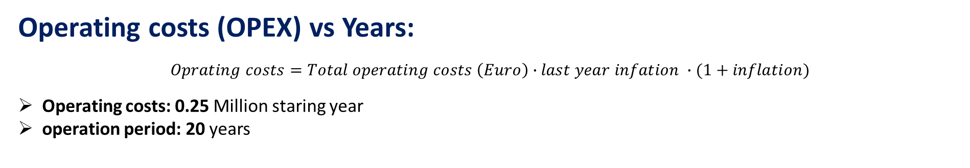
7. Economic Analysis
Operating costs (OPEX) vs Years:
$$Oprating costs=Total operating costs \left(Euro\right)∙last year infation ∙(1+inflation)$$
Operating costs: 0.25 Million staring year
operation period: 20 years
Figure 7.4: Operating cost Vs Years [own]

Slide 34
7. Economic Analysis
Debt service Vs Years:
Repayment: 0.4 million euro/year
Bank interest rate: 9 %
Duration of repayment: 17 years
Figure 7.5: Investment [own]
Figure 7.6: Debt service Vs years [own]

Slide 35
7. Economic Analysis
Taxes Vs Years:
Taxes Free: First 10 years
After 10 years: 30%
Figure 7.7: Taxes Vs years [own]

Slide 36
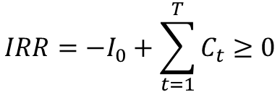
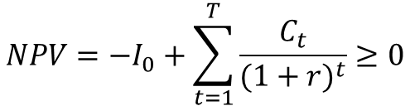
7. Economic Analysis
 | Value | Unit
NPV | 303,893 (0.3 Million) | EUR
IRR | 8.730 | %
LEC | 0.0179 | EUR
Min. DSCR | 1.11
ADSCR | 1.40
$$NPV=−I_{0}+\sum_{t=1}^{T}{\frac{C_{t}}{{(1+r)}^{t}}≥0}$$
$$IRR=−I_{0}+\sum_{t=1}^{T}{C_{t}≥0}$$
Positive NPV
Impressive IRR
Project promises cost efficiency and financial stability
Profitable project
NPV = Net Present Value, IRR = Internal Rate of Return, LEC = Levelized Cost of Energy, Min. DSCR = Minimum Debt Service Coverage Ratio, ADSCR = Average Debt Service Coverage Ratio
Table 7.2: Financial result of wind farm [own]

Slide 37
8. Barriers and Obstacles
High bank tax rate
Land Use Conflicts
Maintenance Issues
Grid Integration
Limited Awareness
Preference for Solar Energy
Low energy price

Slide 38
9. Project Development Timeline
From Greenfield to Operation:
Total timeline: 5 years – 9 years
Site Assessment
Planning
Financing
Commissioning
2-6 months
4-7 months
6-12 months
12-20 months
12 -15 months
18 -30 months
6-12 months
3-6 months
Study Laws and Regulations
Land Leasing
Permitting
Constructions
Optimizing timeline: 3.5 years - 5 years

Slide 39
10. Future Strategy
Vision for 2030
Vision of India:
To achieve 500 GW renewable energy capacity
140 GW (28%) will be Wind energy production
2024:
29.5 GW
2030:
128.6 GW
Figure 10.2: Vision of Gujarat renewable energy production for 2030 [own]
Vision of Gujarat:
To achieve 128.6 GW renewable energy capacity
Increase the share of wind energy to 24%
Launch the first phase of offshore wind projects.
Figure 10.1: Vision of India renewable energy production for 2030 [own]

Slide 40
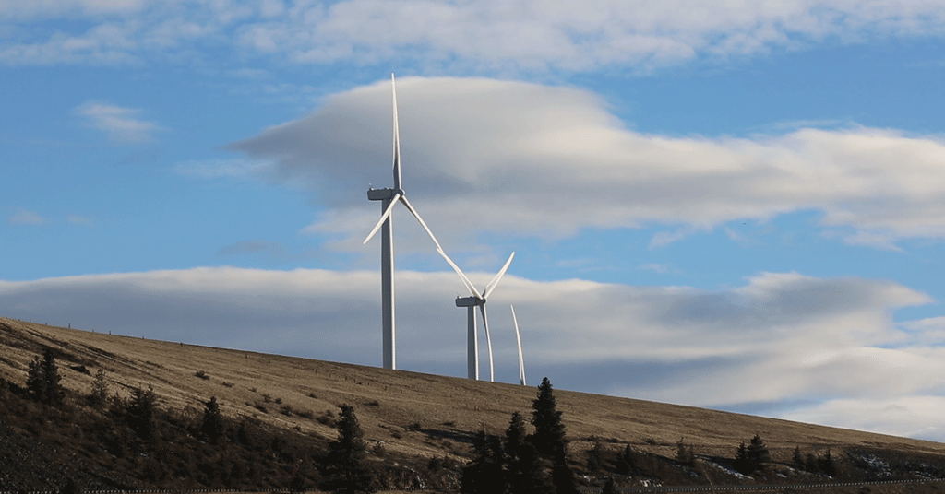
10. Future Strategy
Vision for 2050
Establish Gujarat as a global leader in wind energy.
Fully integrate smart grid solutions for efficient energy distribution.
Achieve a 50% reduction in carbon emissions from energy production.
Figure 10.3: Onshore wind turbine [44]

Slide 41

10. Future Strategy
1
Integrating smart grid
2
Improve Policy support
3
Energy storage system
4
Upgrade infrastructure
5
Advanced turbine technologies
6
Encouraging community engagement
7
Spend more money in research and development of wind turbine

Slide 42
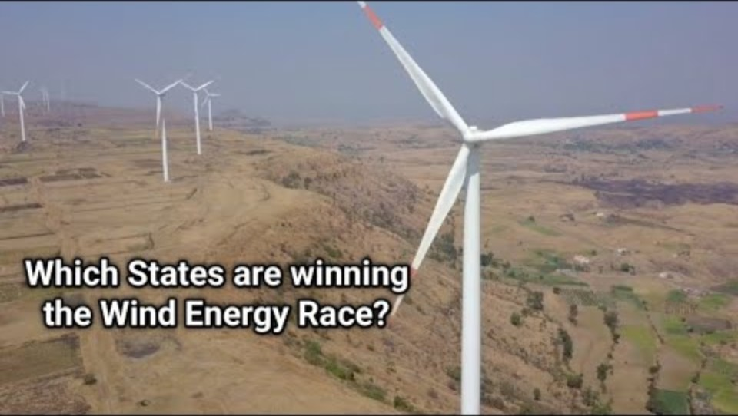
11. Short video: India’s Wind Energy Potential
[ https://www.youtube.com/watch?v=F_jBS1S-9oE&t=6s ]

Slide 43
12. References
[1] “MINISTRY OF NEW AND RENEWABLE ENERGY,” 01 2024. [Online]. Available: https://mnre.gov.in/wind-overview. [Accessed 2024 10 02].
[2] “A Deep Dive into Wind Energy Farms in India: Tapping into the Power of the Breeze,” Green Energy, 23 01 2024. [Online]. Available: https://powerefficiency.com/wind-energy-farms-in-india/. [Accessed 02 10 2024].
[3] “gujarat-bags-award-for-highest-wind-power-installed-capacity,” thehindubusinessline, 15 06 2024. [Online]. Available: https://www.thehindubusinessline.com. [Accessed 2 10 2024].
[4] A. P. Z. P. C. Draxl, “Wind Resource Assessment,” NREL National Renewable Energy Laboratory, July, 2014.
[5] M. Gupta, “Scaling Challenges In Gujarat: Adani’s 300 MW Wind Farm Project And Its Journey Through Regulatory And Logistical Hurdles,” WINDINSIDER EMPOWERING THE WIND SECTOR, 13 05 2024. [Online]. Available: https://windinsider.com. [Accessed 10 10 2024].
[6] Suzlon Group, “Suzlon secures a repeat order of 193.2 MW from The KP Group in Gujarat,” 21 December 2023. [Online]. Available: https://www.suzlon.com. [Accessed 13 10 2024].
[7] MINISTRY OF NEW AND RENEWABLE ENERGY, “Clarification to the ‘Guidelines for Development of Onshore Wind Power Projects’ and amendments,” Government of India, 18 12 2024. [Online]. Available: https://mnre.gov.in/en/document/clarification-to-the-guidelines-for-development-of-onshore-wind-power-projects-and-amendments/. [Accessed 15 11 2024].
[8] thc.nic.in, “THE HAZARDOUS WASTES (MANAGEHANDLING AND TRANSBOUNDARY MOVEMENT) RULES, 2008,” Official Gazeette, MARCH, 2010.
[9] Forest Clearance, “Forest Conservation Rules,” 2003. [Online]. Available: https://forestsclearance.nic.in. [Accessed 17.11.2024].
[10] National Board for Wildlife, Ministry of Environment and Forest, India, “Guidelines for linear infrastructure intrusions in natural areas: roads and powerlines,” 10 Octomber 2011. [Online]. Available: https://moef.gov.in. [Accessed 25 11 2024].
[11] India Air Force, “GUIDELINES FOR ISSUE OF NOC FOR CONSTRUCTIONS AROUND INDIAN AIR FORCE AERODROMES,” 12 2021. [Online]. Available: https://indianairforce.nic.in. [Accessed 11 11 2024].
[12] DTU, “GLOBAL WIND ATLAS,” DTU, ESMAP, WORLD BANK GROUP, VORTEX, [Online]. Available: https://globalwindatlas.info. [Accessed 24 11 2024].

Slide 44
12. References
[13] GEOFABRIK, “OpenStreetMap Data Extracts,” [Online]. Available: https://download.geofabrik.de/. [Accessed 25 11 2024].
[14] Openinframap, [Online]. Available: openinframap.org. [Accessed 26 12 2024].
[15] Government of Gujarat, “Policy-2023 for leasing the government fallow land for green hydrogen production using non-conventional energy sources such as solar, wind, wind solar hybrid energy.,” 08 May 2023. [Online]. Available: https://www.eqmagpro.com. [Accessed 13 10 2024].
[16] ARCADIS India Pvt. Ltd., “ENVIRONMENTAL & SOCIAL IMPACT ASSESSMENT: 250 MW Wind Power Project in Kutch district, Gujarat,” ARCADIS, Kutch, 2017.
[17] Gujarat Goverment , “policy_files,” 2016. [Online]. Available: https://geda.gujarat.gov.in. [Accessed 28 11 2024].
[18] suzlon, “supply-chain-management-and-manufacturing,” 2024. [Online]. Available: https://www.suzlon.com. [Accessed 12 12 2024].
[19] A. Joshi, “Gujarat Sets ₹2.84/kWh Tariff for wind projects below 10 MW comnnissioned by 2027,” MERCOM Clean Energy Insights, 04 09 2024. [Online]. Available: https://www.mercomindia.com. [Accessed 25 12 2024].
[20] Macrotrends, “India Inflation Rate 1960-2024,” Macrotrends LLC, [Online]. Available: https://www.macrotrends.net. [Accessed 25 12 2024].
[21] U. Ehlers, Project financing in the wind power sector (Lecture Note), Flensburg, Germany: Hochschule Flensburg Prof. Marina Blohm, 20.11.2024.
[22] EI News Network, “GERC Updates Regulations for Small Wind Projects,” energetica INDIA, 05 September 2024. [Online]. Available: https://www.energetica-india.net. [Accessed 27 12 2024].
[23] iNDEXTb/GM(Project&Tech.), “Wind Farm - An Opportunity for Investment in Gujarat,” Goverment of Gujarat, Gandhinagar.
[24] M. B. Arshi Banu P S, “Wind energy feasibility and wind turbine selection studies for the city Surat, India,” Clean Energy, vol. 8, no. 3, pp. 166-173, 2024.
[25] L. C. a. A. B. Vaisakh Suresh Kumar, “Scaling up small wind turbines in India (Barriers and options for the way forward),” WRI-INDIA.ORG and CLEAN , Delhi, 2024.
[26] A. P. a. Z. P. . Draxl, “Wind Resource Assessment,” National Renewable Energy Laboratory (NREL), 2014.
[27] R. m. https://www.mercomindia.com/gujarat-land-policy-solar-wind-projects, “Gujarat's New Land Policy for Solar, Wind Projects to Make Developers More Accountable,” MERCOM, Clean Energy Insights, 17 September 2020. [Online]. Available: https://www.mercomindia.com/gujarat-land-policy-solar-wind-projects. [Accessed 05 10 2024].

Slide 45
12. References
[28] D. M. Blohm, Lecture Notes on Wind Farm Development, Flensburg, 2024.
[29] EU-INDIA CLEAN ENERGY & CLIMATE PARTNERSHIP, “About the partnership,” European Union , 30 March 2016. [Online]. Available: https://www.cecp-eu.in. [Accessed 13 10 2024].
[30] Nature India, “Is the drive for clean energy throwing environmental caution to the wind?,” NEWS FEATURE, 16 June 2019.
[31] P. C. Abhishek Gawande, “Environmental and social impacts of wind energy: a view point with reference to India,” Indian Institute of Forest Management, Bhopa, 2019.
[32] Gujarat Urja Vikas Nigam Ltd, “REQUEST FOR SELECTION (RfS),” 10 07 2023. [Online]. Available: https://jmkresearch.com. [Accessed 20 10 2024].
[33] V. Shah, “India Sets Sail on 1 GW Offshore Wind Energy Projects in Gujarat, Tamil Nadu,” goodreturns, 19 June 2024. [Online]. Available: https://www.goodreturns.in. [Accessed 22 10 2024].
[34] Editorial Team, “Gujarat: Pioneering Sustainable Wind Power Generation in India,” SSMB.IN, 19 September 2024. [Online]. Available: https://ssmb.in/2024/09/19/gujarat-pioneering-sustainable-wind-power-generation-in-india/. [Accessed 22 10 2024].
[35] GE VERNOVA, “GE acquires 49% stake in Continuum onshore wind farm in support of the energy transition in India,” GE, [Online]. Available: https://www.gevernova.com. [Accessed 22 10 2024].
[36] Gujarat Energy Development Agency, Gujarat Government, [Online]. Available: https://geda.gujarat.gov.in. [Accessed 22 10 2024].
[37] Wind farm BoP, “Wind farm testing and commissioning,” 2017, [Online]. Available: https://www.windfarmbop.com/. [Accessed 22 10 2024].
[38] India Renewable energy race :- https://www.downtoearth.org.in/renewable-energy/india-s-renewable-energy-race-mp-up-will-take-more-than-50-years-to-meet-2022-target-at-current-pace-85195, 10/01/2025
[39] India Wind Potential, https://www.tandfonline.com/doi/full/10.1080/15435075.2021.1978447, 10/01/2025.
[40] https://www.indianclimate.com/show-data.php?request=CRBLWINFEW
[41] https://www.netsolwater.com/what-is-major-environmental-conflicts-in-india-with-example.php?blog=130
[42] https://www.sciencedirect.com/science/article/pii/S2214629621004357

Slide 46
12. References
[43] the world's biggest blackout, 31th July 2012 [source:nbcnews]
[44] https://sl.bing.net/hVlnu47HBZs
[45] https://www.google.com/maps
[46] Ministry of Road Transport & Highways (MoRTH), India – Notification GSR No. 414(E), June 2020
[47] https://www.crematrix.com/blog/what-are-the-different-types-of-commercial-leases-in-india
[48] enercon.de
[49] indiabirdwatching.com
[50] M. Ram, D. Gadhavi, A. Sahu, and D. Devaliya, "Unravelling the secrets of lesser florican: a study of their home range and habitat use in Gujarat, India," Scientific Reports, vol. 13, no. 1, Nov. 2023, doi: 10.1038/s41598-023-46563-5.
What to know more about project?
Check out our GitHub →

